Slide 1
DATA SCIENCE CAPSTONE PROJECT
Battle of Neighborhoods

Slide 2
INTRODUCTION
Mr. X, a food technologist, manufactures and supplies tea and coffee dispenser machine to food eateries in the most common venues in the Central district of Delhi and makes good profit. He supplies to the most common venues as they attract the maximum customers resulting in higher profits and good branding for his products for future growth.
To play safe he is thinking of checking the similarity between different districts of Delhi & expand his business in the district that is most similar to Central Delhi.
So to check the similarity between different districts of Delhi, considering both the population as well as the most common venues is important.
Aim: To perform K Means to cluster different districts based on their population & most common food venues & select the most appropriate district for business expansion.
The target audience is Mr. X.

Slide 3
DATA
The data on population in each of the 11 districts has been extracted from https://www.nriol.com/india-statistics/delhi/districts.asp using BeautifulSoup library & the unnecessary columns are dropped from the table. The population is normalized to get the population fraction.
Foursquare API is used to get the nearby venues in each of the districts with the help of the location coordinates. The top 20 most common venues for each district are then displayed using one-hot encoding.

Slide 4
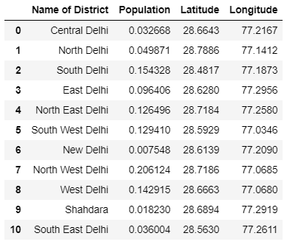
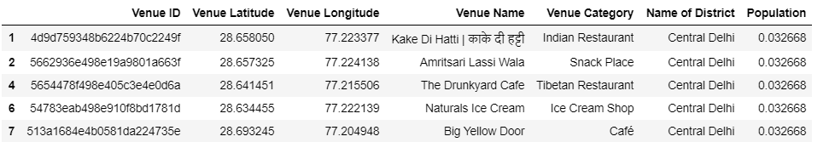
Table 1: Districts of Delhi dataframe
Table 2: List of nearby venues

Slide 5
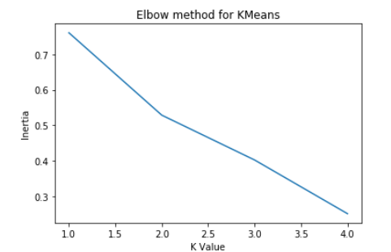
METHODOLOGY
I have used K Means for making clusters based on population & most common venues. The elbow point is determined to get the optimal value of K.
I have plotted these clusters on the map of Delhi using Folium.
K Means Elbow Point

Slide 6
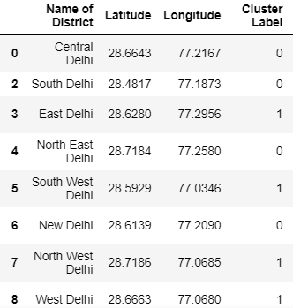
Table 3: Cluster Labels using K Means

Slide 7
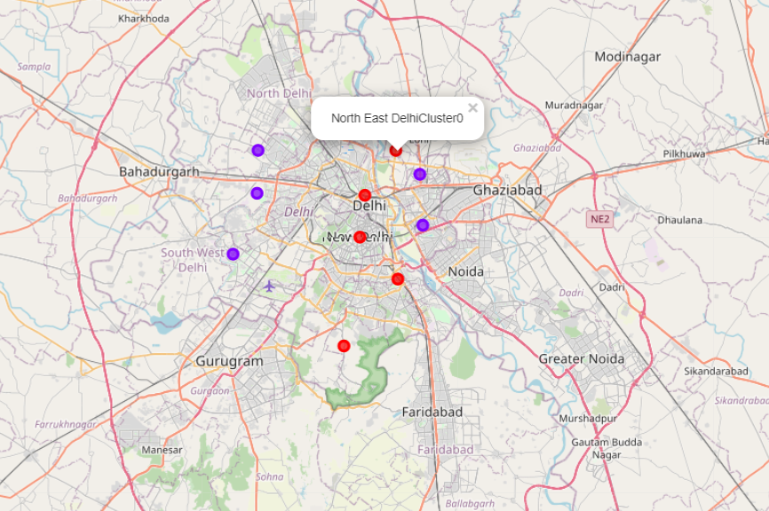
Map of Delhi specifying the clusters

Slide 8
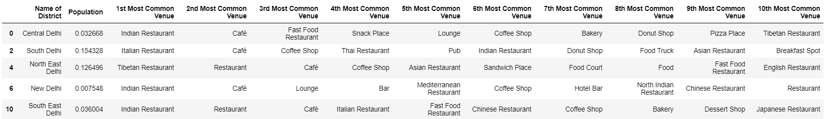
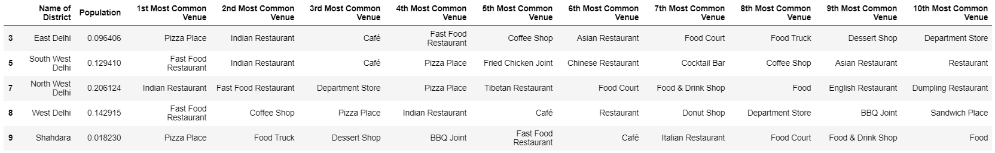
RESULT
The 1st cluster consists of the following districts:- Central Delhi, South Delhi, North East Delhi, New Delhi & South East Delhi.
The 3rd cluster consists of the following districts:- East Delhi, South West Delhi, North West Delhi, West Delhi & Shahdara.
Table 4: Cluster 1
Table 6: Cluster 2

Slide 9
RESULT
We are interested in the cluster having "Central Delhi".
In Central Delhi, most common are Indian Restaurant, Café & Fast Food Restaurant.
In South Delhi, most common are Italian Restaurant, Café & Coffee Shop.
In North East Delhi, most common are Tibetan Restaurant, Restaurant & Café.
In New Delhi, most common are Indian Restaurant, Café & Lounge.
In West Delhi, most common are Fast Food Restaurant, Coffee Shop & Pizza Plaza.
In South East Delhi, most common are Indian Restaurant, Restaurant & Café.
Also, the district with the highest population among these 5 is South Delhi.
Now, New Delhi District has same top 2 most common eateries but the population is way lesser than Central Delhi. This means that even the most common venues would not be having enough footfall.

Slide 10
DISCUSSION
If we look at all the common venues, it is clearly evident that South East Delhi has 5 similar venues as Central Delhi. Also it has the similar population as Central Delhi.
So, Mr. X can expand his business in South East Delhi.

Slide 11
CONCLUSION
The purpose of this project was to explore the different districts of Delhi keeping in mind population & nearby food eateries.
One of the limitations of this project is that I have assigned the population in the district to each food outlet in the district. However, each district of Delhi is quite big in size and needs to be broken down to neighborhoods to get a more accurate representation but neighborhood level population data was not available for Delhi.
Therefore, with the available information, it is safe to conclude that South East Delhi would be the best option for Mr. X.

